Slide 1
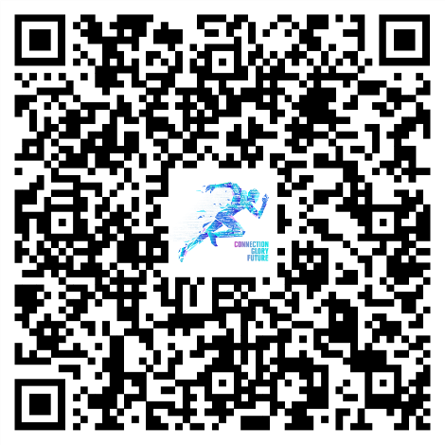
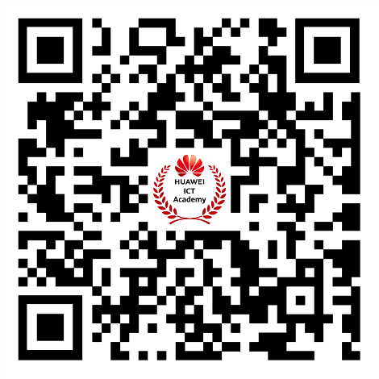
主题色
72%
0/250/236
0%
63/17/212
36%
36/17/212
62%
0/250/96
01. Introduction
The Huawei ICT Competition for the Middle East and Central Asia, presented in partnership with UNESCO IITE (Institute for Information Technologies in Education), is dedicated to advancing digital learning and fostering collaboration between industry and education. This annual global ICT talent exchange event is specifically designed for students, offering a prestigious platform to showcase their talents and gain worldwide recognition for their achievements. We invite all students, along with Huawei ICT Academies, universities, colleges, and educational institutions from the Middle East and Central Asia to participate in the 2024–2025 ICT Competition.
This Competition will be held at 3 levels; National, Regional and Global. Regional and Global Awards Ceremonies will be held on-site.
02. Schedule
Registration/ Road Show | National Preliminary | National Final | Competition Training | Regional Final
August – October | October | November | November – December, 2024 | TBD
03. Regional Final Award
*Awards for the national finals will differ from every country.
Practice Competition | Award | Number of Team | Number of Tutor | Prize
Network Track | Grand Prize | 1 (3 students) | 1 | HUAWEI MateBook Award Certification
 | First Prize | 1 (3 students) | 1 | Huawei Matepad Award Certification
 | Second Prize | 2 (6 students) | 2 | Huawei Watch Award Certification
 | Third Prize | 10 (30 students) | 10 | Award Certification
Cloud Track | Grand Prize | 1 (3 students) | 1 | HUAWEI MateBook Award Certification
 | First Prize | 1 (3 students) | 1 | Huawei Matepad Award Certification
 | Second Prize | 2 (6 students) | 2 | Huawei Watch Award Certification
 | Third Prize | 10 (30 students) | 10 | Award Certification
Computing Track | Grand Prize | 1 (3 students) | 1 | HUAWEI MateBook Award Certification
 | First Prize | 1 (3 students) | 1 | Huawei Matepad Award Certification
 | Second Prize | 2 (6 students) | 2 | Huawei Watch Award Certification
 | Third Prize | 10 (30 students) | 10 | Award Certification
At the Award Ceremony for the ME&CA Regional Competition, we will honor “Excellent ICT Academy Award” & “Excellent Instructor Award ”, the criteria for the regional award are as follows:
Excellent ICT Academy Award
1.Register or renew as a recognized ICT Academy for the year 2024. 2.Be among the top 20% of ICT Academies in your country based on the student participation in the ICT Competition Preliminary Exam and study Huawei courses on the Talent platform. 3.Have a minimum of 4 students who achieve HCIx Certification.
Excellent Instructor Award 1. Associate with a valid ICT Academy in 2024 and obtain an HCAI certification. 2. Open valid classes on the Huawei Talent platform and successfully train more than two students to obtain HCIx Certification.
04. Competition Content
Network track
IP technologies such as Datacom, Security, WLAN and DCN
Cloud track
Information technologies such as Cloud, Big Data, and AI
Computing track
Technologies such as openEuler, openGauss, and Kunpeng
New
05. Competition Form
Practice Competition | Venue | Exam | Duration (Minutes) | Question Quantity | Question Type | Total Score
National Preliminary | Online | Theory exam | 90 | 60 | true or false, single-answer, and multiple-answer questions | 1000
National Final | Online | Theory exam | 90 | 90 | true or false, single-answer, and multiple-answer questions | 1000
Regional Final | Online | Theory exam | 60 | 60 | true or false, single-answer, and multiple-answer questions | 1000
 | Offline | Lab exam | 240 | / | scenario-based comprehensive lab exam | 1000
06. Competition Rules
National Competitions (Individual /Team competition):
Participants must be enrolled college students with access to a PC and the internet.
Each participant is allowed to enter only one track per year.
From the National Finals through to the Global Finals, the competition will be conducted at the team level. It is recommended that all team members are from the same university.
Grand Prize winners from previous Global Finals are eligible to compete again, provided they enter a different track.
In the preliminary competition of each country, participants who hold valid Huawei certifications will receive bonus points. （It is recommended to use the competition learning space to access previous learning materials.）
HCIE Certificate: 200 points;
HCIP Certificate: 100 points;
HCIA Certificate: 50 points;
(Points can be accumulated, and the upper limit of bonus points cannot exceed 200 points.)
Regional Finals (Team competition):
The Regional Finals are team competitions, with teams advancing from the National Finals. Team members must remain consistent, and substitutions are generally not permitted.
New
More Information
New
Scan to Register Now
Huawei ICT Academy
Facebook

